Slide 1

Big thanks to everyone!

Slide 2


The convergence of real-time analytics and event-driven applications
@StephanEwen
Flink Forward San Francisco
April 11, 2017

Slide 3
2016 was the year when streaming technologies became mainstream
2017 is the year to realize the full spectrum of streaming applications

Slide 4
Some large scale streaming applications

Slide 5



@
Detecting fraud in real time
As fraudsters get better, need to update models without downtime
Live 24/7 service
Credit card
transactions
Notifications
and alerts
Evolving fraud
models built by
data scientists

Slide 6



@
Athena X
SQL to define metrics
Thresholds and actions to trigger
Blends analytics and actions
SQL, thresholds,
actions
Streams from Hadoop, Kafka, etc
Analytics
Alerts
Derived streams

Slide 7

@
Route events to Kafka, ES, Hive
Complex interaction sessions rules
Mix of stateless / small state / large state
Stream Processing as a Service
Launching, monitoring, scaling, updating
DSL to define jobs

Slide 8

@
Blink based on Flink
A core system in Alibaba Search
Machine learning, search, recommendations
A/B testing of search algorithms
Online feature updates to boost conversion rate
Alibaba is a major contributor to Flink
Contributing many changes back to open source

Slide 9


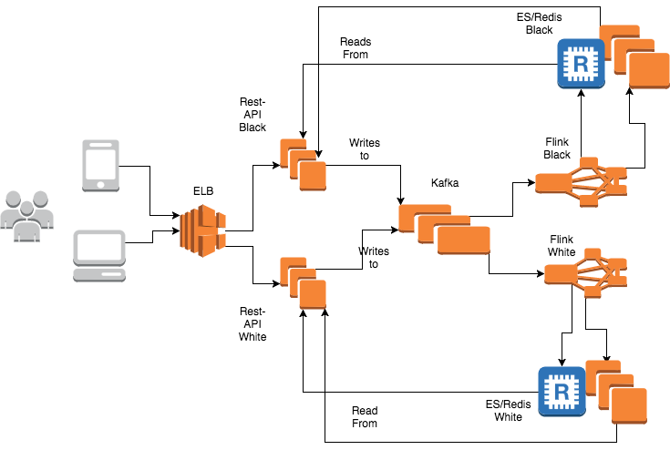

@
Complete social network implemented using event sourcing and CQRS (Command Query Responsibility Segregation)

Slide 10
What can we learn from these?
All these applications run on Flink ☺
Applications, not just analytics
Not just finding out what the data means but acting on that at the same time
Workloads going beyond the traditional Hadoop realm
Hadoop is possible deploy, source, and sink
Container engines and other storage systems increasingly popular with Flink

Slide 11
So, what is data streaming?
First wave for streaming was lambda architecture
Aid batch systems to be more real-time
Second wave was analytics (real time and lag-time)
Based on distributed collections, functions, and windows
The next wave is much broader: A new architecture for event-driven applications

Slide 12
Event–driven applications

Slide 13

Event–driven applications
Stateful, event-driven, event-time-aware processing
Stream Processing
Event-driven Applications
(streams, windows, …)
(event sourcing, CQRS, …)
Batch Processing
(data sets)

Slide 14
Events, State, Time, and Snapshots
f(a,b)
Event-driven function executed distributedly

Slide 15
Events, State, Time, and Snapshots
Maintain fault tolerant local state similar to any normal application
f(a,b)

Slide 16
Events, State, Time, and Snapshots
wall clock
f(a,b)
Access and react to notions of time and progress, handle out-of-order events
event time clock

Slide 17

Events, State, Time, and Snapshots
Snapshot point-in-time view for recovery, rollback, cloning, versioning, etc.
wall clock
f(a,b)
event time clock

Slide 18
Event–driven applications
Stateful, event-driven, event-time-aware processing
Stream Processing
Event-driven Applications
(streams, windows, …)
(event sourcing, CQRS, …)
Batch Processing
(data sets)

Slide 19
The APIs
Analytics
Stream SQL
Stream- & Batch Processing
Table API (dynamic tables)
DataStream API (streams, windows)
Stateful Event-Driven Applications
Process Function (events, state, time)

Slide 20
Process Function
class MyFunction extends ProcessFunction[MyEvent, Result] {
// declare state to use in the program
lazy val state: ValueState[CountWithTimestamp] = getRuntimeContext().getState(…)
def processElement(event: MyEvent, ctx: Context, out: Collector[Result]): Unit = {
// work with event and state
(event, state.value) match { … }
out.collect(…) // emit events
state.update(…) // modify state
// schedule a timer callback
ctx.timerService.registerEventTimeTimer(event.timestamp + 500)
}
def onTimer(timestamp: Long, ctx: OnTimerContext, out: Collector[Result]): Unit = {
// handle callback when event-/processing- time instant is reached
}
}

Slide 21
Data Stream API
val lines: DataStream[String] = env.addSource( new FlinkKafkaConsumer09<>(…))
val events: DataStream[Event] = lines.map((line) => parse(line))
val stats: DataStream[Statistic] = stream
.keyBy("sensor")
.timeWindow(Time.seconds(5))
.sum(new MyAggregationFunction())
stats.addSink(new RollingSink(path))

Slide 22
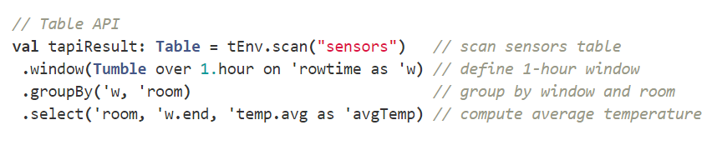

Table API & Stream SQL

Slide 23
Streaming Architecture for Event-driven Applications

Slide 24
Compute, State, and Storage
Classic tiered architecture
Streaming architecture
compute +
compute
layer
application state
database
layer
stream storage
and
snapshot storage
(backup)
application state
+ backup

Slide 25
Performance
Classic tiered architecture
Streaming architecture
all modifications are local
synchronous reads/writes
across tier boundary
asynchronous writes
of large blobs

Slide 26
Consistency
Classic tiered architecture
Streaming architecture
exactly once per state
snapshot consistency across states
=1
=1
distributed transactions
at scale typically
at-most / at-least once

Slide 27
Scaling a Service
Classic tiered architecture
Streaming architecture
provision compute
provision compute and state together
separately provision additional database capacity

Slide 28
Rolling out a new Service
Classic tiered architecture
Streaming architecture
provision compute and state together
provision a new database (or add capacity to an existing one)
simply occupies some additional backup space

Slide 29
Time, Completeness, Out-of-order
Classic tiered architecture
Streaming architecture
event time clocks define data completeness
?
event time timers handle actions for out-of-order data

Slide 30
Repair External State
Streaming architecture
backed up data (HDFS, S3, etc.)
wrong results
streams
(lets say Kafka etc)
live application
external state

Slide 31
Repair External State
Streaming architecture
backed up data (HDFS, S3, etc.)
application on backup input
overwrite with correct results
streams
(lets say Kafka etc)
live application
external state

Slide 32
Repair External State
Streaming architecture
backed up date (HDFS, S3, etc.)
application on backup input
overwrite with correct results
Each service doubles as a batch job!
streams
(lets say Kafka etc)
live application
external state

Slide 33
Streaming has outgrown the Hadoop Stack
Event-driven applications and realtime analytics converge with Apache Flink
Event-driven applications become easier to manage, faster, and more powerful following a streaming architecture implemented with Flink

